Slide 1
Finemate
Learning is a piece of cake.

Slide 2

Students
Communities
Knowledge
Effortless
Digital Infrastructure
Dopamine
Learners
Institutes
Pocket Money
Revision
Mental Health

Slide 3
Finemate is a software platform that helps students and professionals retain knowledge and improve their cognitive abilities.

Slide 4
Problem
Students, Teachers & Professionals often forget things that they have just learned. Do you also face this problem?
Decreased Attention span of students but the same old long teaching approach.
Lack of relatable analogies and a platform where we can learn from the most appropriate or relatable analogies.
Institutes in small cities lack a student management system and those who have are outdated.

Slide 5
Solution
Retention Engine
Social Learning Platform
Student Management System
It helps you to learn better and retain better by algorithmically understanding what you forget often and what not.
A platform for online learning communities so they can clear there doubts, learn together and teach each other what they have excelled.
A Super app that fulfills all the common requirements of Institutes.
1
2
3

Slide 6
Objective
Build Long-term memory and mitigate forgetting.
Connect Learners.
Provide an advance student/school management system to institutes.

Slide 7
So, Are we building any medicinal solution
for Retention ?

Slide 8
1. Retention Engine ?
Retention Engine is a tool that help you understand concepts more deeply and retain knowledge more effectively, while avoiding confusion. It is designed to improve your long-term memory and cognitive abilities.
It employs techniques such as the Leitner system, photographic elements, paraphrasing, scaffolding, gamification, short-form & long-form video lectures and personalized content in a social media alike user interface.
Thought: A Psychological Solution implemented in a Software.

Slide 9
Humans forget 42% of learnings in just 20 minutes and after 60 days only 10% of things are retained when not practiced.
- Herman Ebbinghaus 1885 (translated)
Memory
Time Remembered
Thought: That’s of 1885 what about 2022 when there are more distractions and a low attention span.

Slide 10
What Affects Cognition ?
Cognitive Load
Difficulty Level
Confusion
Prior Knowledge
Language Barrier
Curiosity
Active Memory
Teaching Methods
Distractions
?

Slide 11
2. Social Learning Platform ?
A platform where you can learn from people with different teaching styles, perspectives, and memory aids, and connect with other learners who share your interests and goals. This allows you to expand your knowledge and skills beyond the boundaries of your classroom.

Slide 12
Gyan Batne se badta hai!
Translate English
knowledge increases by sharing.
- Indian Proverb

Slide 13
3. Student Management System ?
A powerful student management system that is designed to fulfill the current requirements of educational institutions. It is a comprehensive platform that provides a range of tools and resources to help institutes manage their students and improve the learning experience.

Slide 14
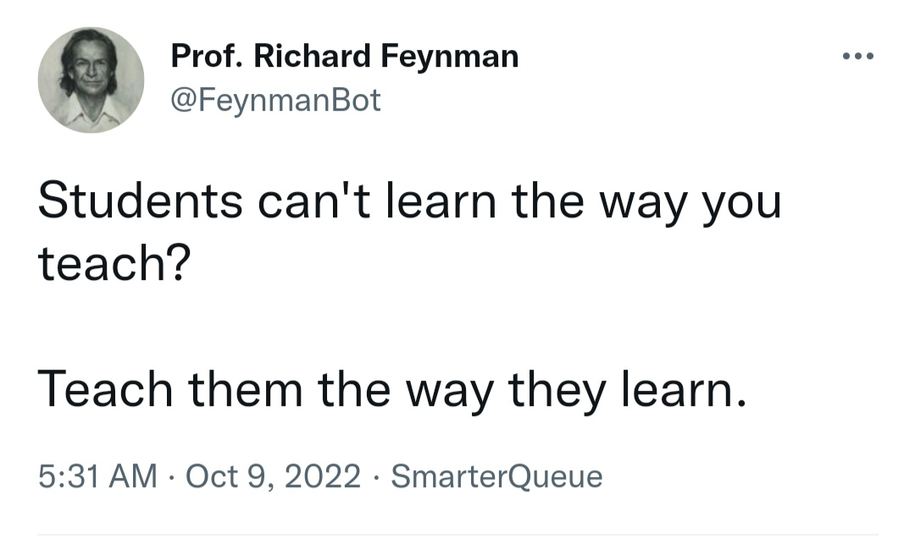
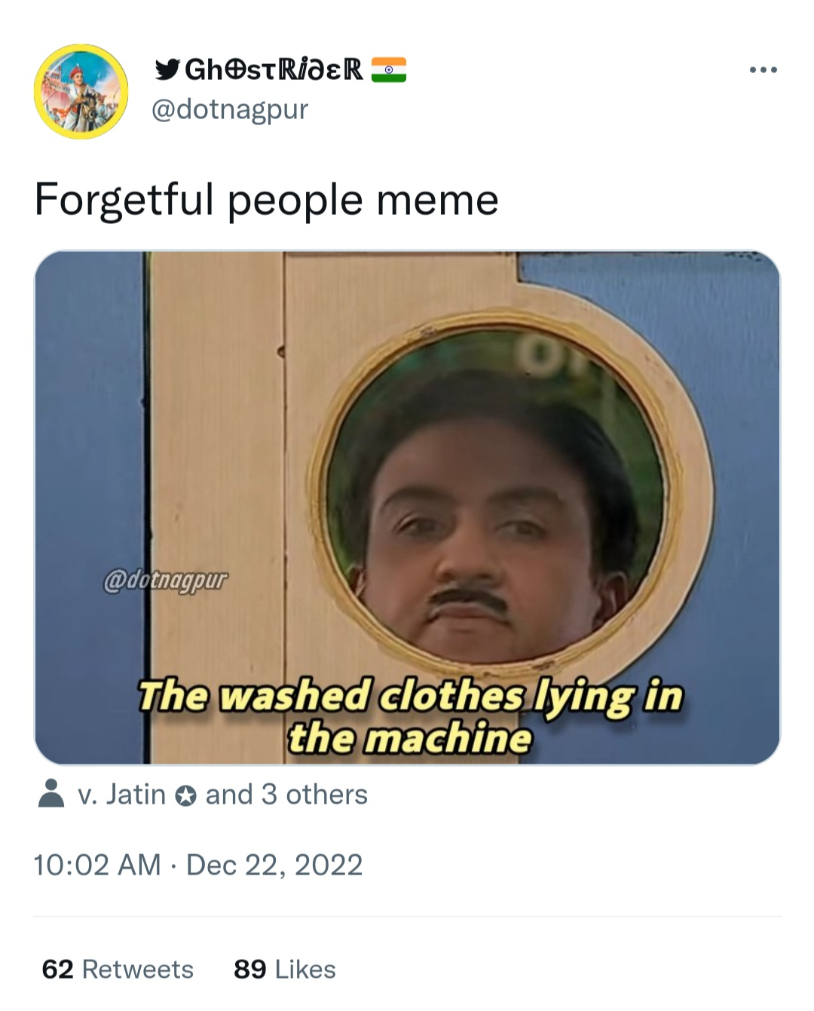
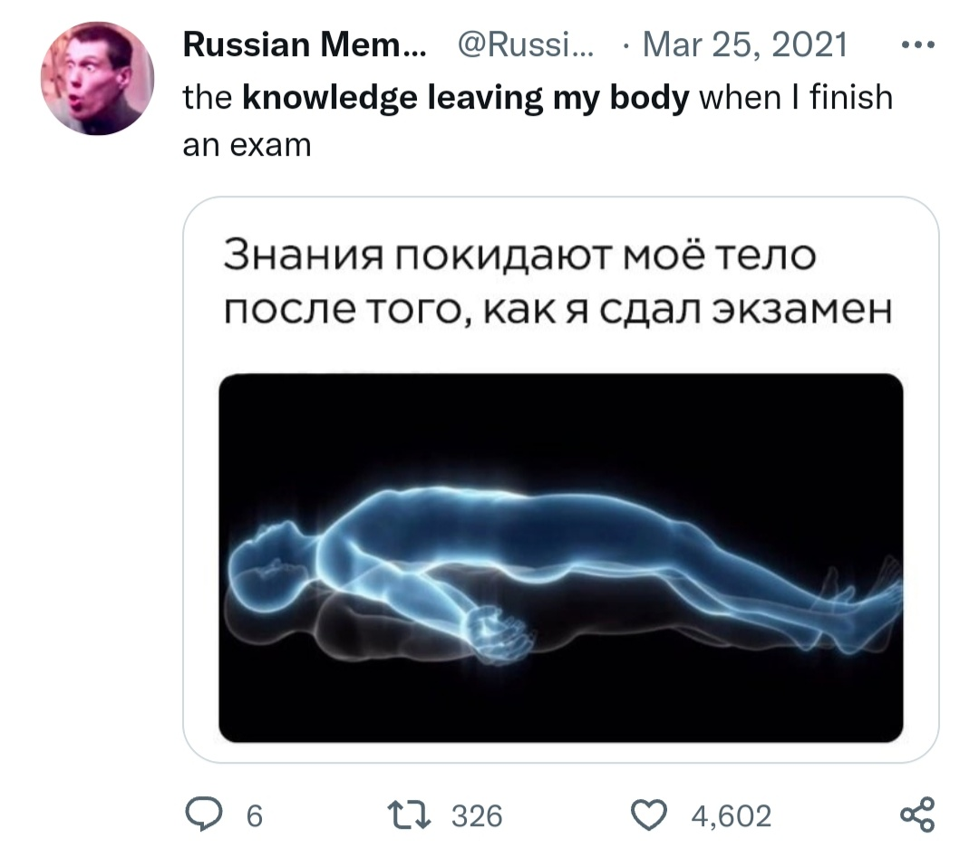
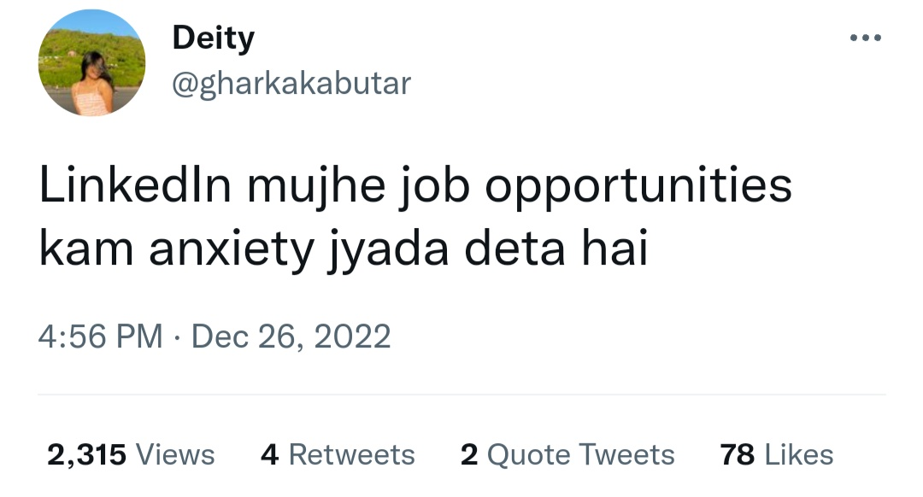

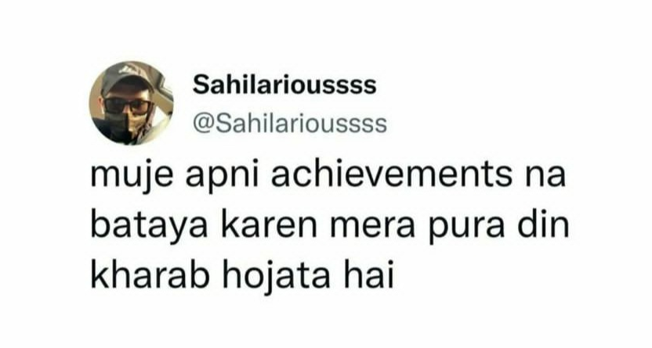
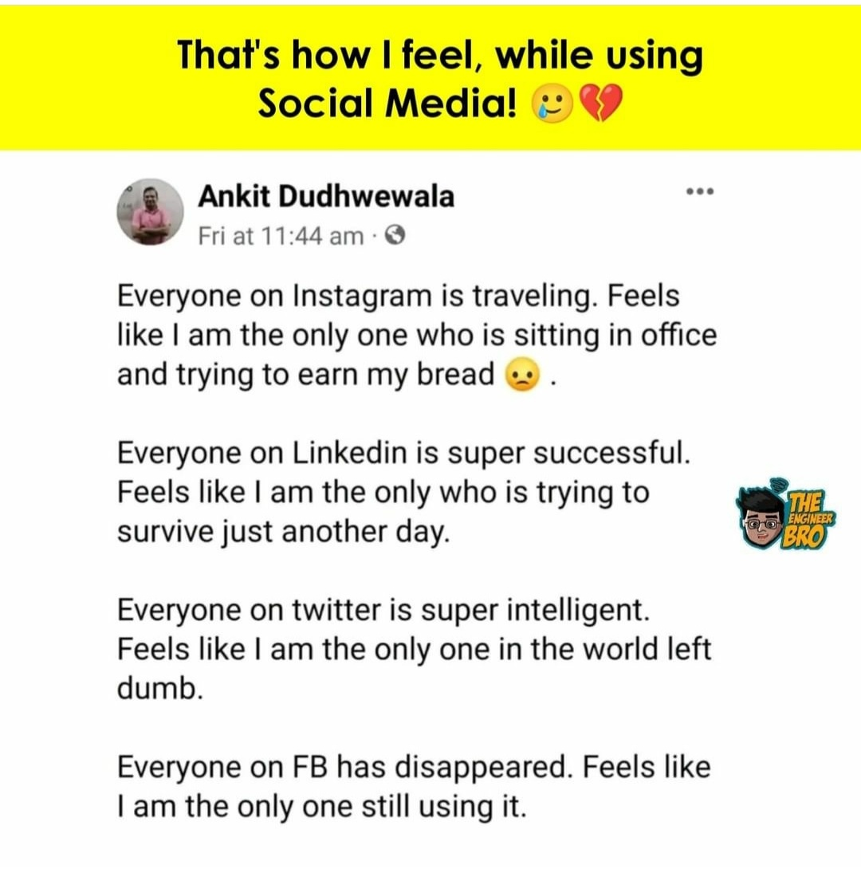

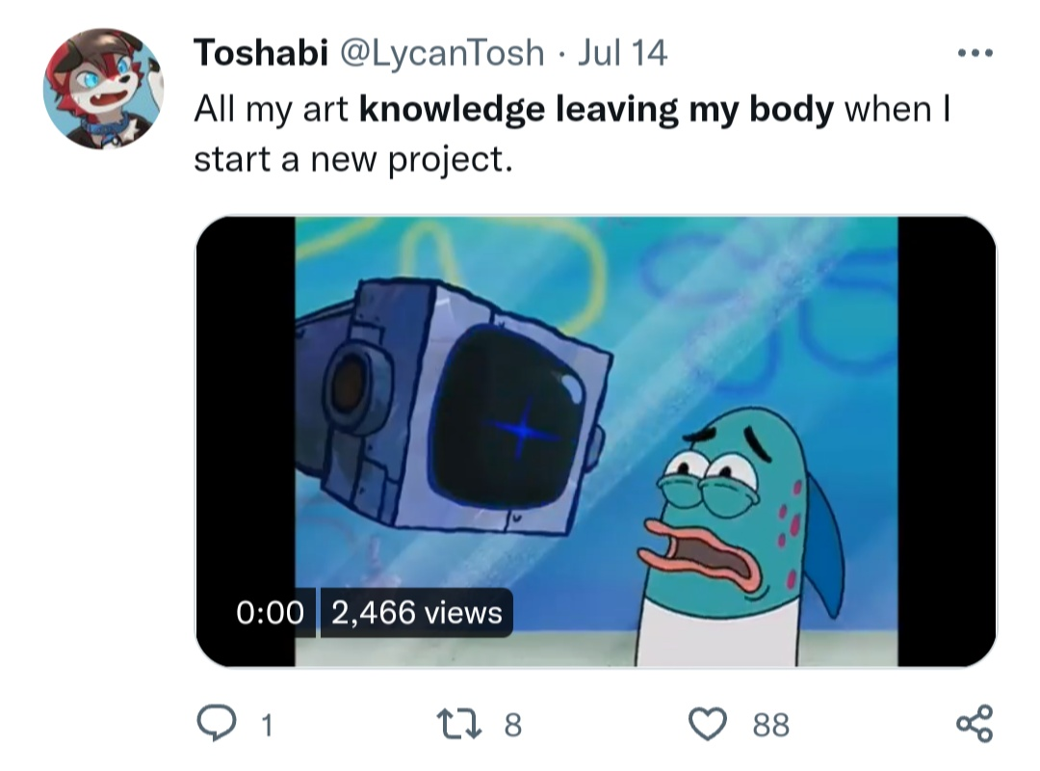
Idea Validation
Thought : Some Recent Memes & Tweets of people who face the problem that appeared on my newsfeed.

Slide 15
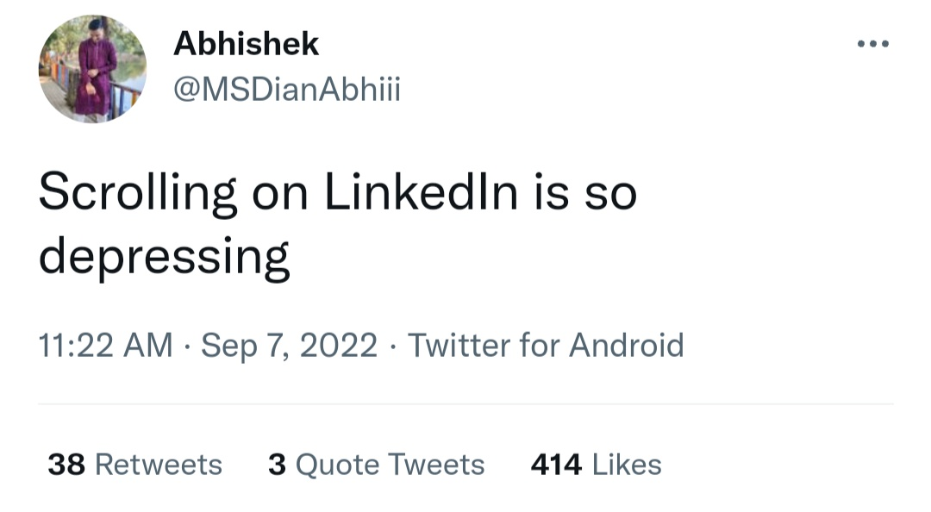
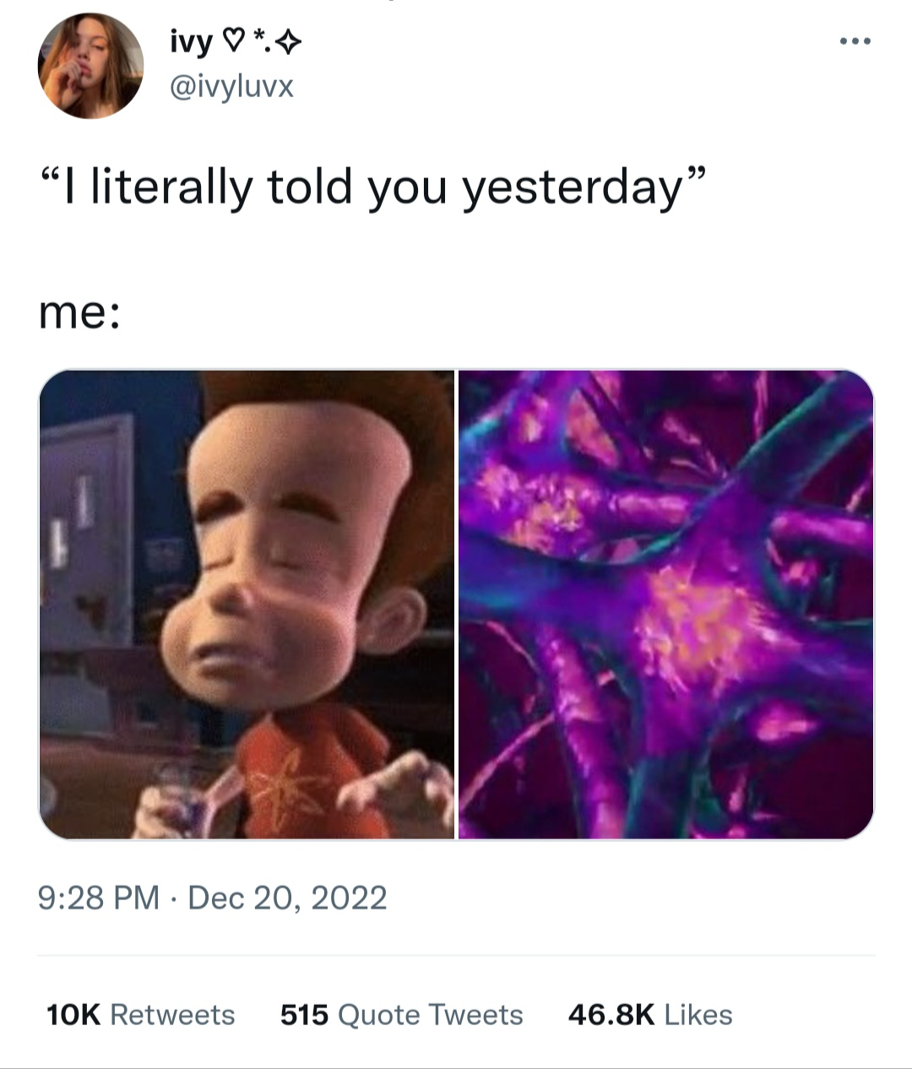


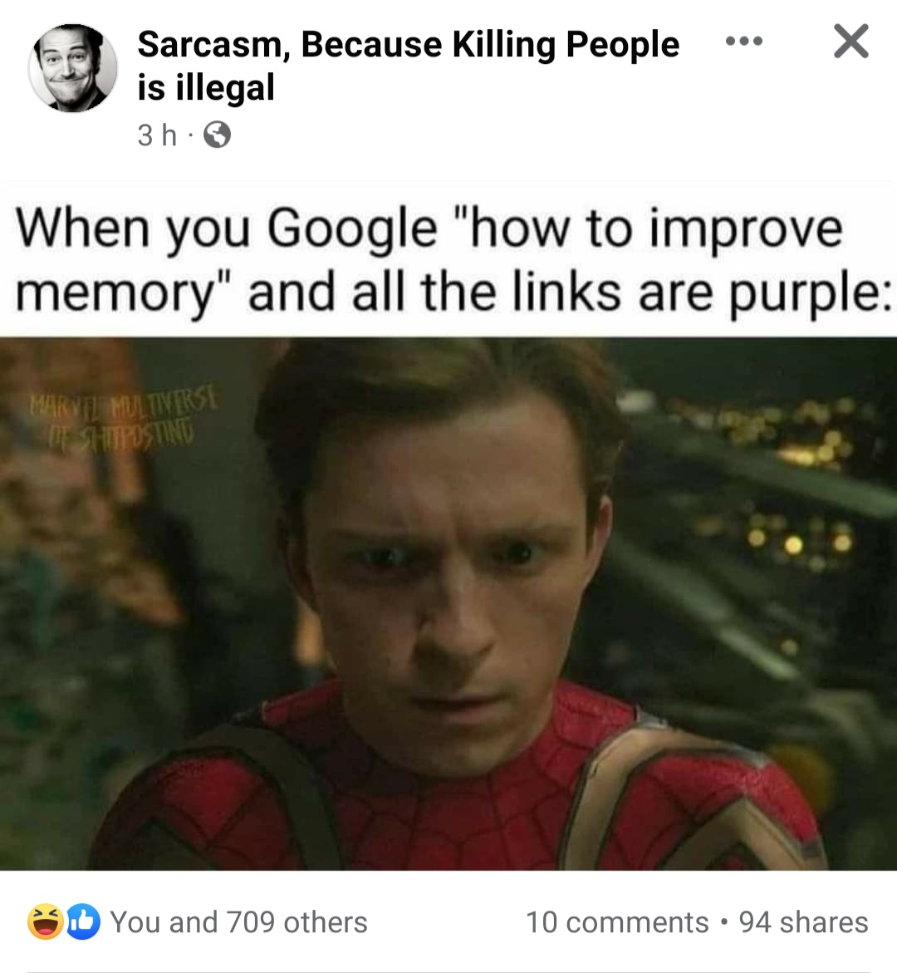
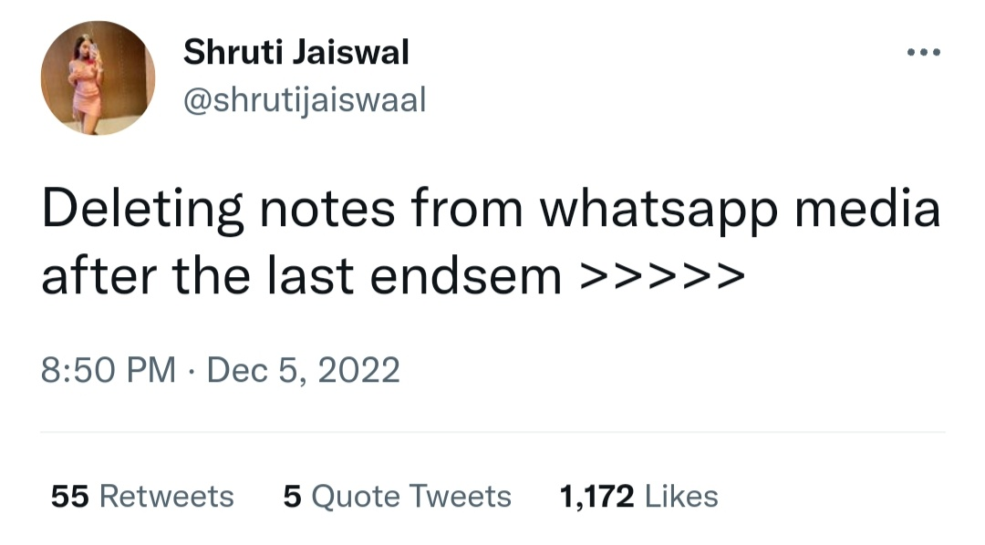
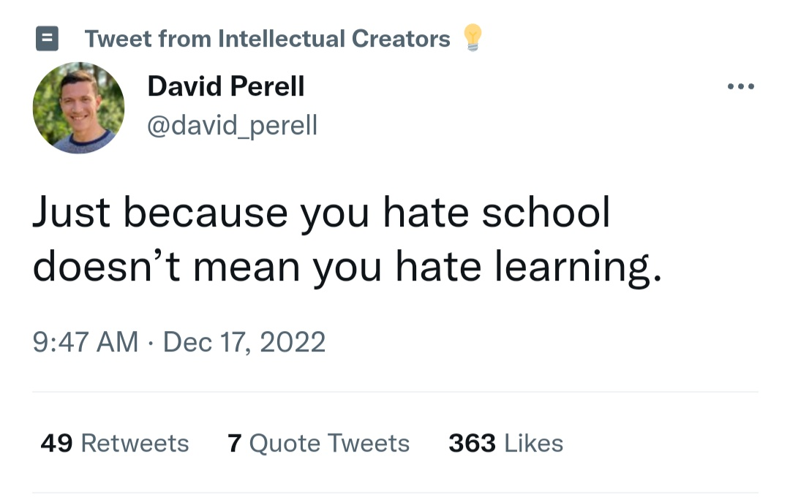
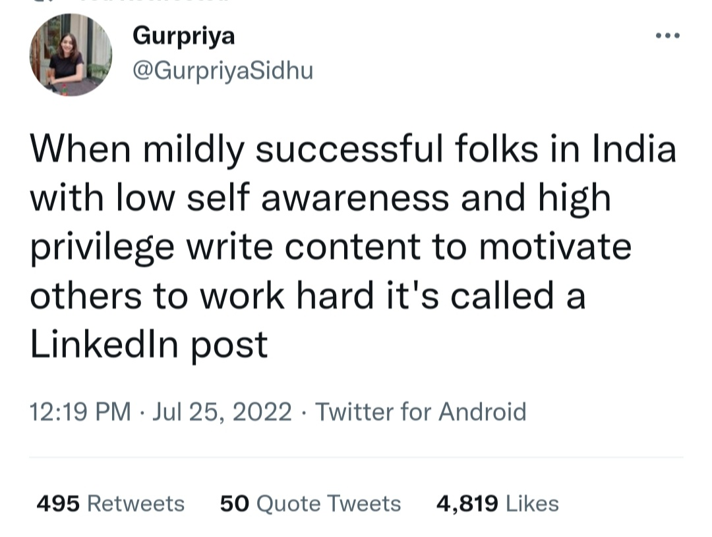
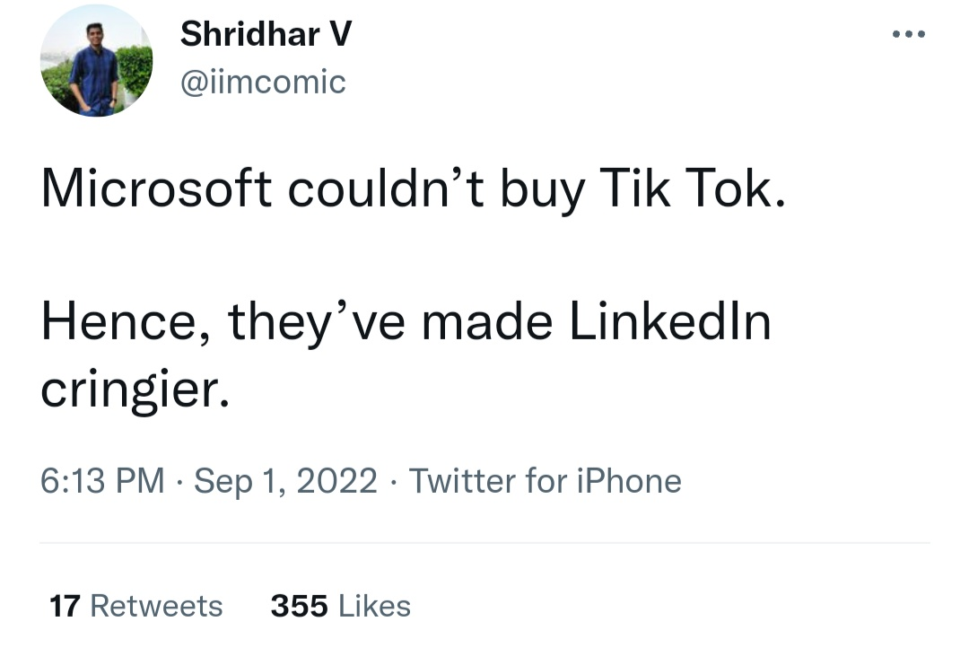
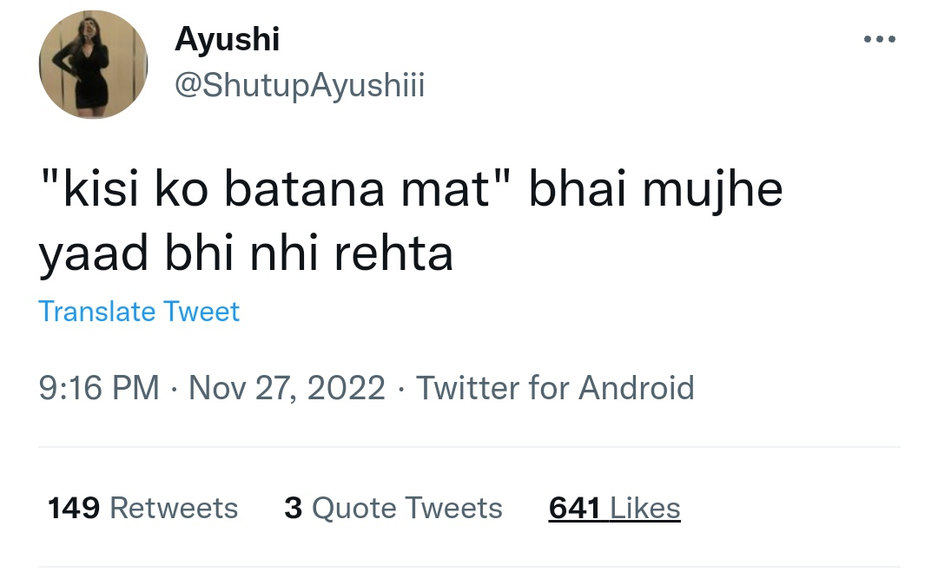
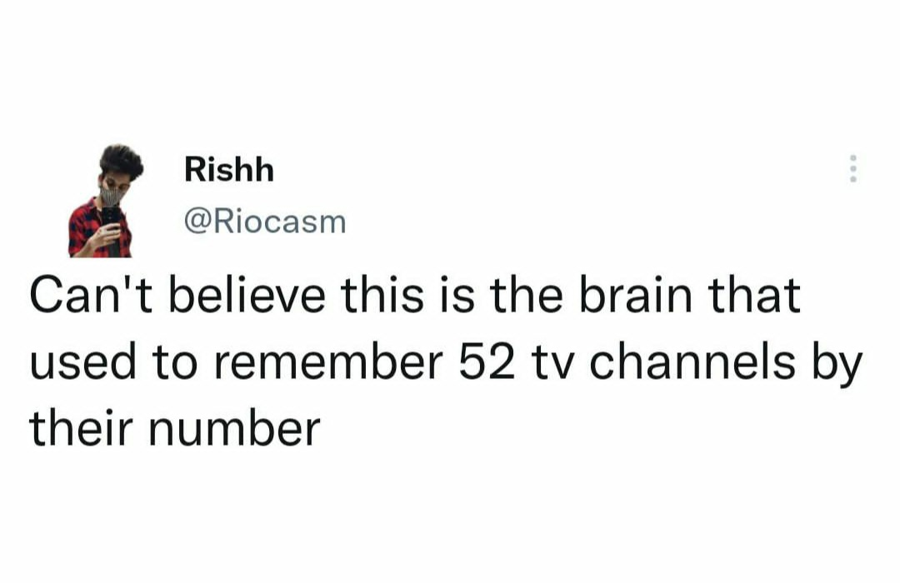

Slide 16
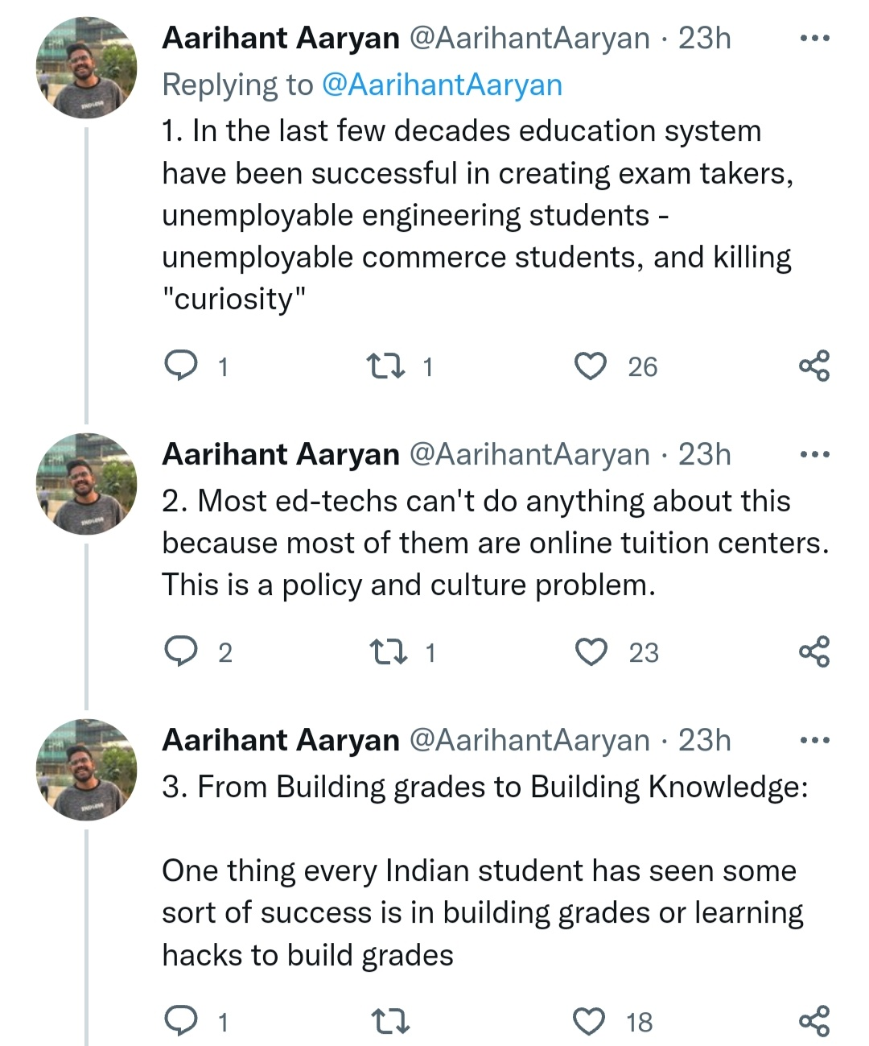
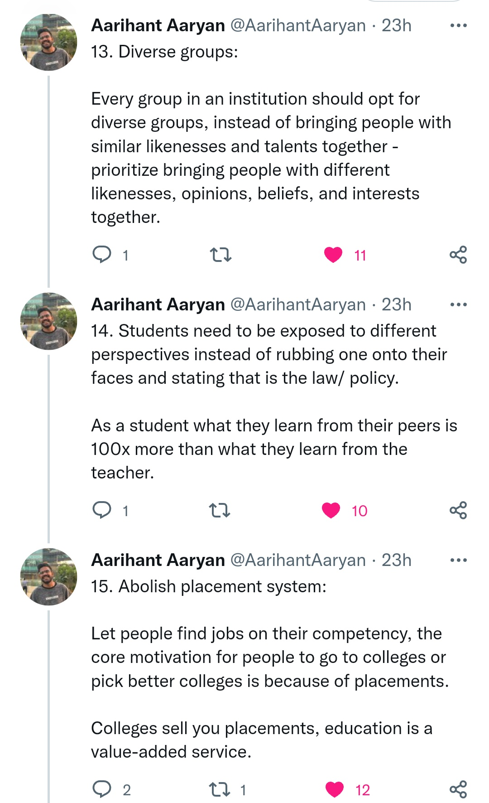
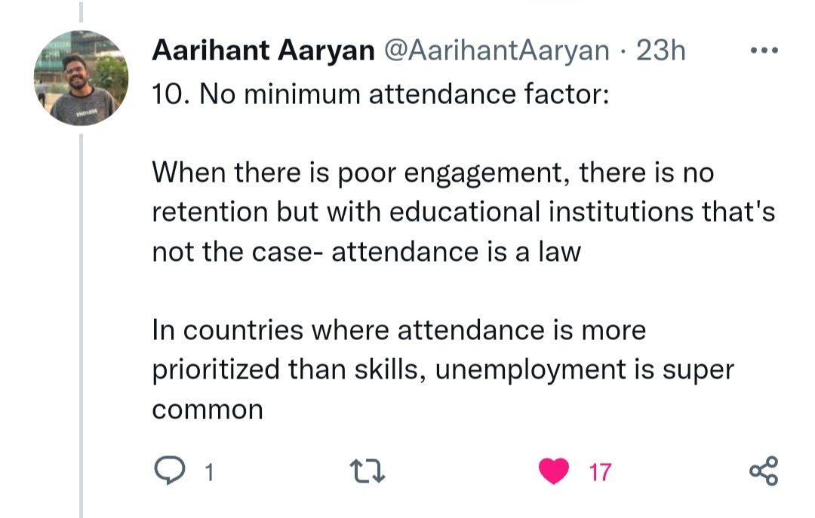
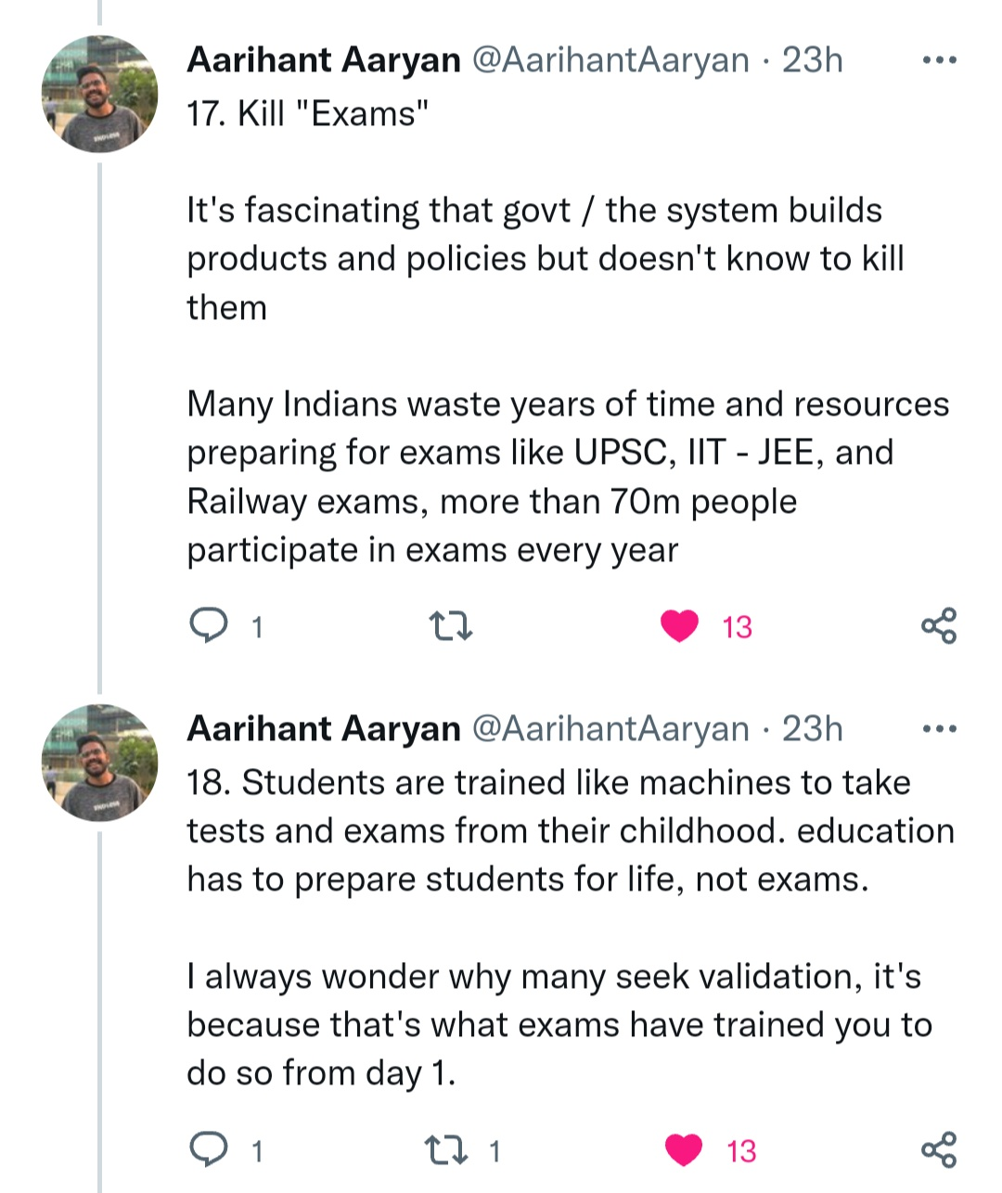
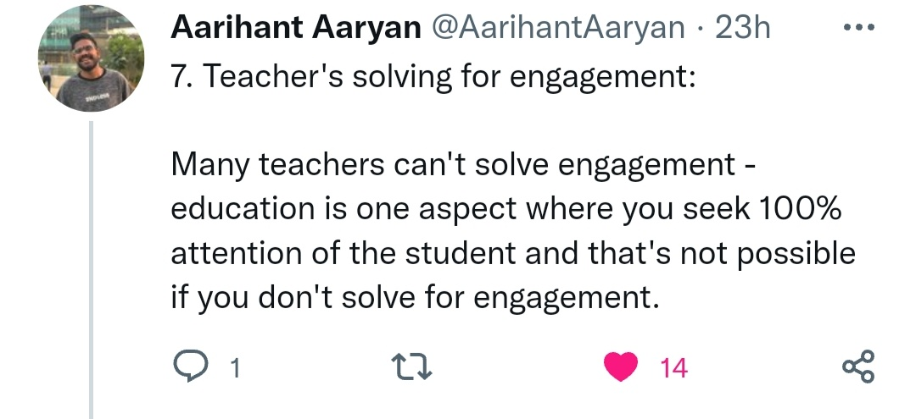
An Additional Slide
https://twitter.com/AarihantAaryan/status/1588032546457411584?s=20&t=lx4URrwhf-B-irhAdcy4kQ

Slide 17
Target Audience & Benefits
Institutes
Improving the students performance which benefits Institutes.
Providing an Advance Student Management System.
Individuals
Building a long-term memory in students/professionals.
Builds a learning community to share expertise and experience.

Slide 18
51,649
3,70,40,000
88,50,00,000
15,00,000
That’s a lot of Schools (Before 12th Standard)
That’s a lot of higher educational institutes(After 12th Standard)
Students(Age: 14-18)
Students(Age: 18-24)
Reported by MHRD Ministry of India in 2020 & 2001

Slide 19
?
Total Number of Learners
Thought: Every Learner can use it to learn and retain better.

Slide 20
Business Model
Service Charges
For Student Management System along with better Learning & Retention Solution.
Network
Leveraging network of students community to later capitalize from advertisement/Affiliate Marketing/Promotions.
Marketplace
To promote students to earn pocket money by selling artworks, used stationary like books, calculators etc to peers or students from other institutes.

Slide 21
Traction
Finemate was made public on 10th November and in 15 days without any sort of marketing gained 100+ users. And as we will start serving institutes we will by default expand network.

Slide 22
Funding Ask
We are asking for 25 Lakhs to develop it further.
The fund will be used for hiring great talent and developing further features and mobile application.

Slide 23
Road Map
Machine Learning Model for Post Recommendation based on interest and forgetting curve (Decay & Interference).
MVP (10-11-22)
Android Application
1
3
5
2
4
6
Pilot project with Institutes
AI powered diagram builder
Marketplace for students

Slide 24

Team
Akshat Jain Bafna
An Software Engineer and a Solopreneur who is intrinsically motivated to solve the problem of Retention and Cognition.
Bachelor in Information Technology from SVVV, Indore
(2018-22)

Slide 25
Thanks!
Any questions? You can find me at:
Email: akshatbjain.aj@gmail.com, contact@finemate.co
Twitter: akshatjainbafna
LinkedIn: akshat-jain-571435139
YouTube: https://youtu.be/2tPOe44aJ0M
Contact: 9425919685

